Slide 1
SDG 14 · LIFE BELOW WATER
From chocolate
to the ocean
Lesson 1 of 4
with Dr Pendo Maro
Notes:
A 50-minute lesson for upper primary (ages 10–12). Learners at the centre: they talk more than you do. Facts, not fear. Full step-by-step instructions are in the teacher guide.

Slide 2
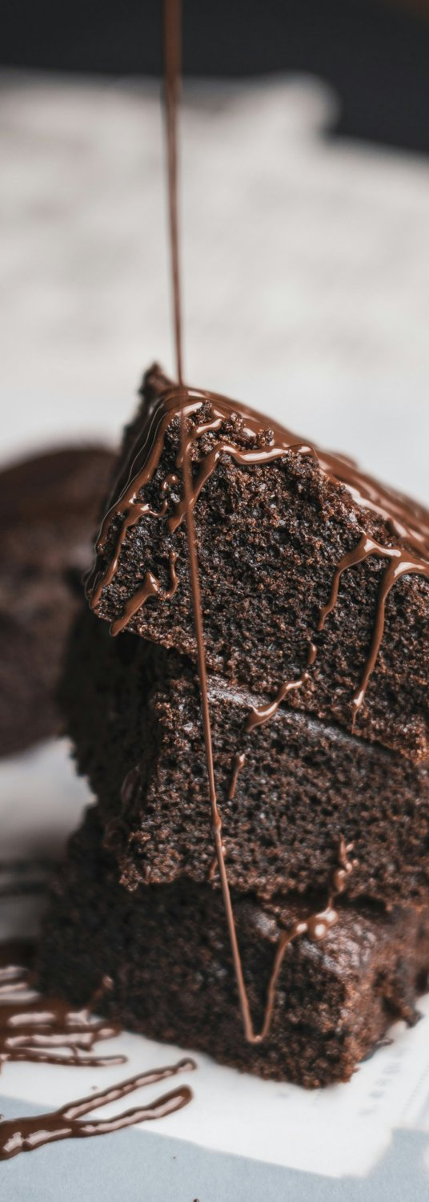
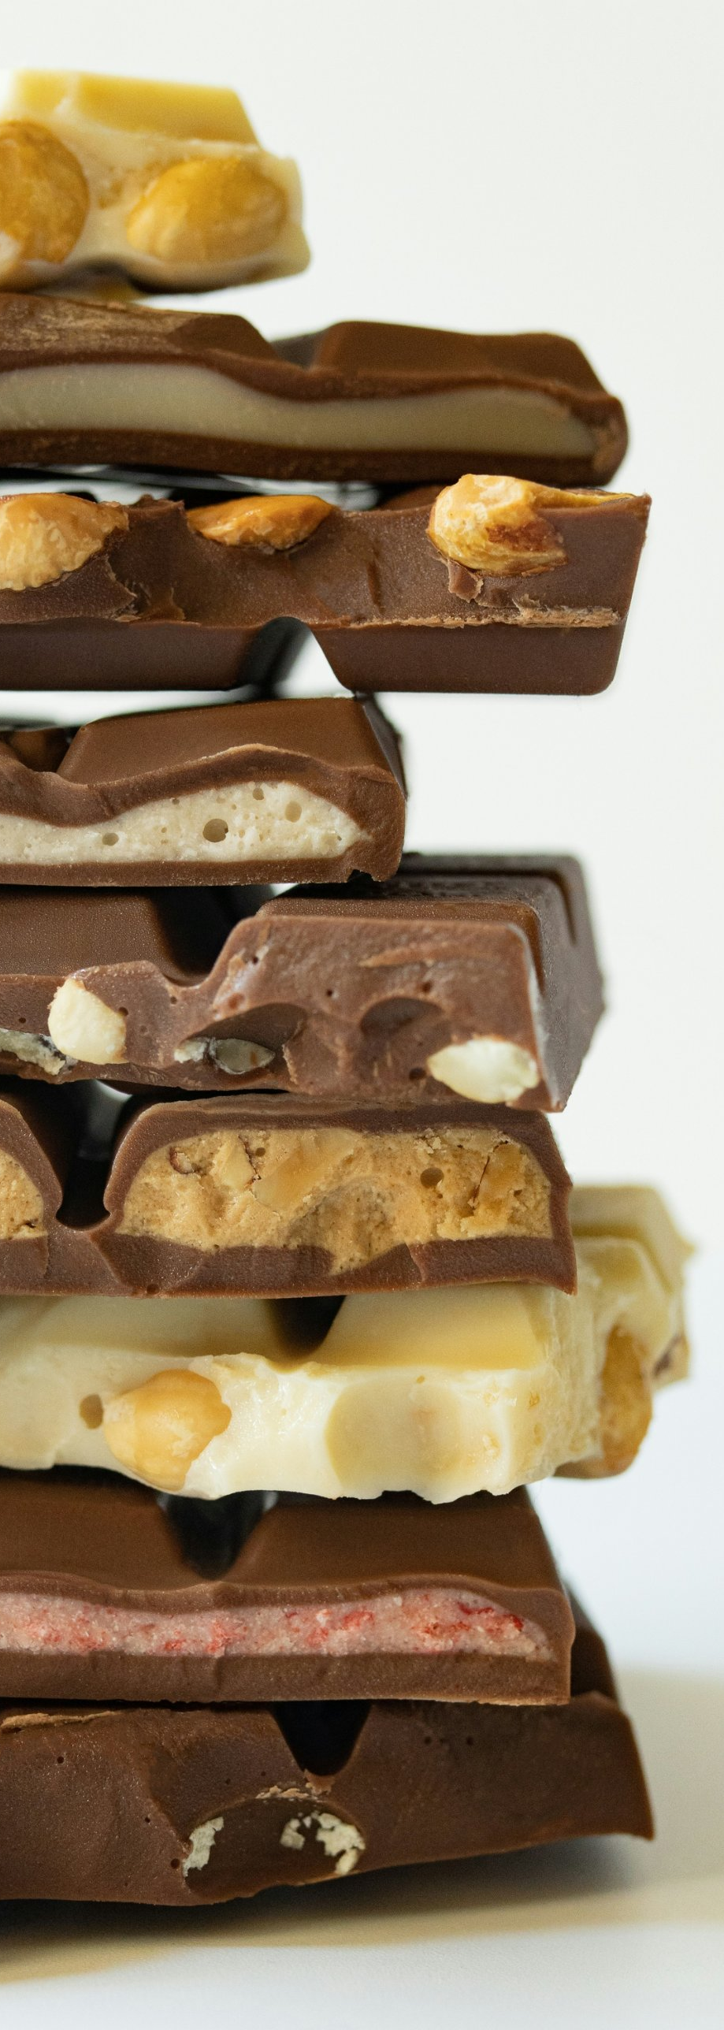
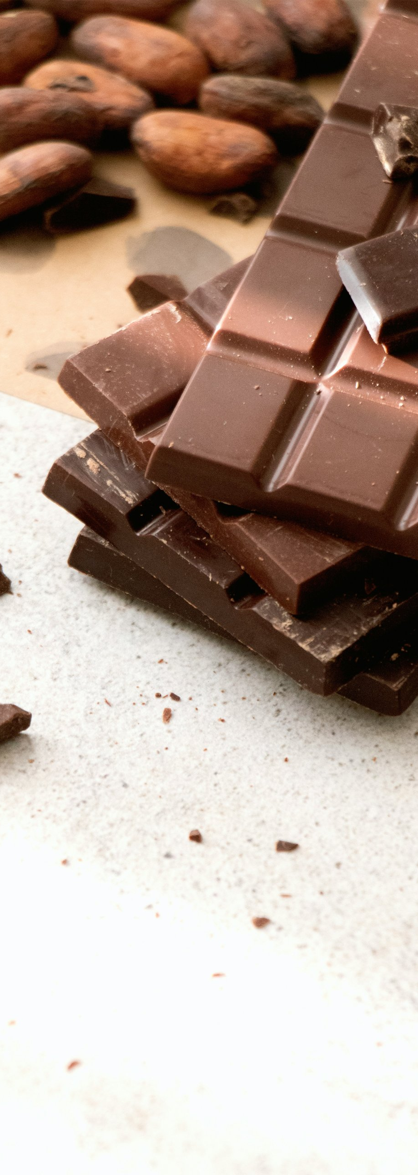
1 · HOOK · 4 MIN
Who likes chocolate?
Where does it come from?
How does it get here?
Photos: Pushpak Dsilva, Julia Zyablova, Tetiana Bykovets / Unsplash
Notes:
Show this slide and ask: “Who likes chocolate? Where does it come from? How does it get here?” Take a show of hands, then let learners guess. Point to the cocoa beans. Show the world map and let them guess the countries and the transport (plane, lorry, ship) before you give the answer: cocoa grows mostly in Côte d’Ivoire and Ghana and travels mainly by ship, often to the port of Antwerp (outside Belgium, use your nearest big port). Finish with: “And the chocolate wrapper – where does it go?” Don’t answer yet; you will come back to it at stage 5.

Slide 3
2 · VIDEO · 5 MIN
Watch and write down one question
▶ Tap here to play the video
youtube.com/watch?v=X0EdDFE_Zv4
Notes:
Give the task before you press play: “While you watch, write down one question.” Check: “How many questions do you write?” (One.) If the video is short, play it twice: once to watch, once to write. Alternative video in English: https://www.youtube.com/watch?v=HQTUWK7CM-Y. Always share the link rather than downloading clips.

Slide 4
3 · OUR QUESTIONS · 8 MIN
Your questions
Chocolate
Waste
The ocean
Notes:
Collect the questions and write them on the board under the three headings. Don’t answer straight away: turn each question back to the class (“What do you think? Who can answer that?”). Concept-check questions you can use: “Does cocoa grow in Belgium?” (No.) “Does a bottle thrown into the sea disappear in a year?” (No, it breaks into tiny pieces.) Keep questions about harm to animals and corals for stage 5. Short answers are in the teacher guide.

Slide 5
4 · THE CHOCOLATE JOURNEY · 8 MIN
The chocolate journey
1
2
In groups, put the 8 cards in order
What does this journey leave behind?
Notes:
Put learners into groups of 3–4. Set the task before handing anything out: “In your group, put the cards in order, from the cocoa tree to your mouth.” Check: “How many cards will you get?” (Eight.) “Do you work alone or together?” (Together.) Hand out one shuffled set per group and give them about 4 minutes. Check the order with the answer key in the teacher guide. Then ask: “What does this journey leave behind?” (Waste, packaging, smoke and fumes from lorries and ships.) Make the link: making and transporting our things creates waste and gases that warm the planet; the ocean receives both our waste and much of that extra heat.

Slide 6
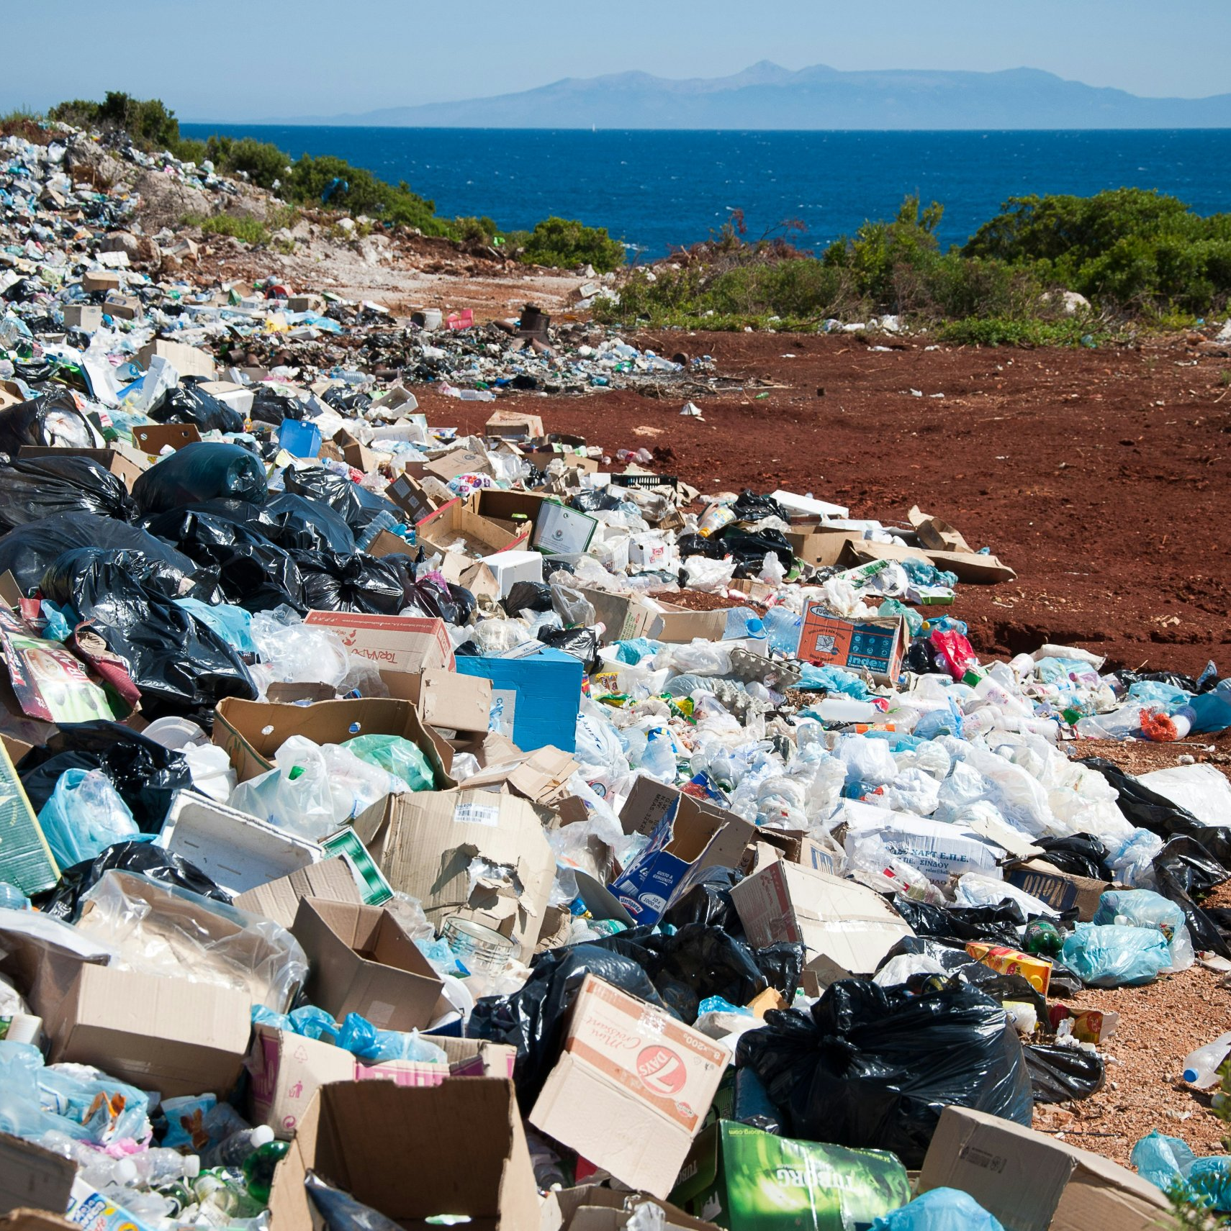
5 · WHY IT MATTERS · 7 MIN
Where does our packaging go?
Three figures to help us understand
Photo: Antoine Giret / Unsplash
Notes:
Give learners 10 seconds to look at the photo, then ask: “What can you see? Where is the sea?” Then show the three figures on the next slides, one at a time. For each one, ask the question on the slide and let learners answer in their own words before you move on. Keep to three figures.

Slide 7
AROUND THE WORLD · 1 / 3
11 million
tonnes of plastic end up in the ocean every year
Does this plastic ever go away?
Source: The Pew Charitable Trusts and SYSTEMIQ, Breaking the Plastic Wave, 2020
Notes:
Answer: no, it breaks into tiny pieces called microplastics. Add the good news: every piece we sort properly stays out of the sea. For curious learners: without action, this figure could almost triple by 2040 (same source).

Slide 8
ANIMALS · 2 / 3
914 species
of sea animals swallow plastic or get tangled in it: turtles, birds, fish, whales…
Is an animal that eats plastic healthy?
Source: Kühn and van Franeker, Marine Pollution Bulletin, 2020
Notes:
Answer: no. Then ask: “How does plastic hurt animals?” They swallow it (a turtle can mistake a plastic bag for a jellyfish) or get tangled in it, for example in lost fishing nets. 914 is the number of species where this has been recorded; there are almost certainly more.

Slide 9
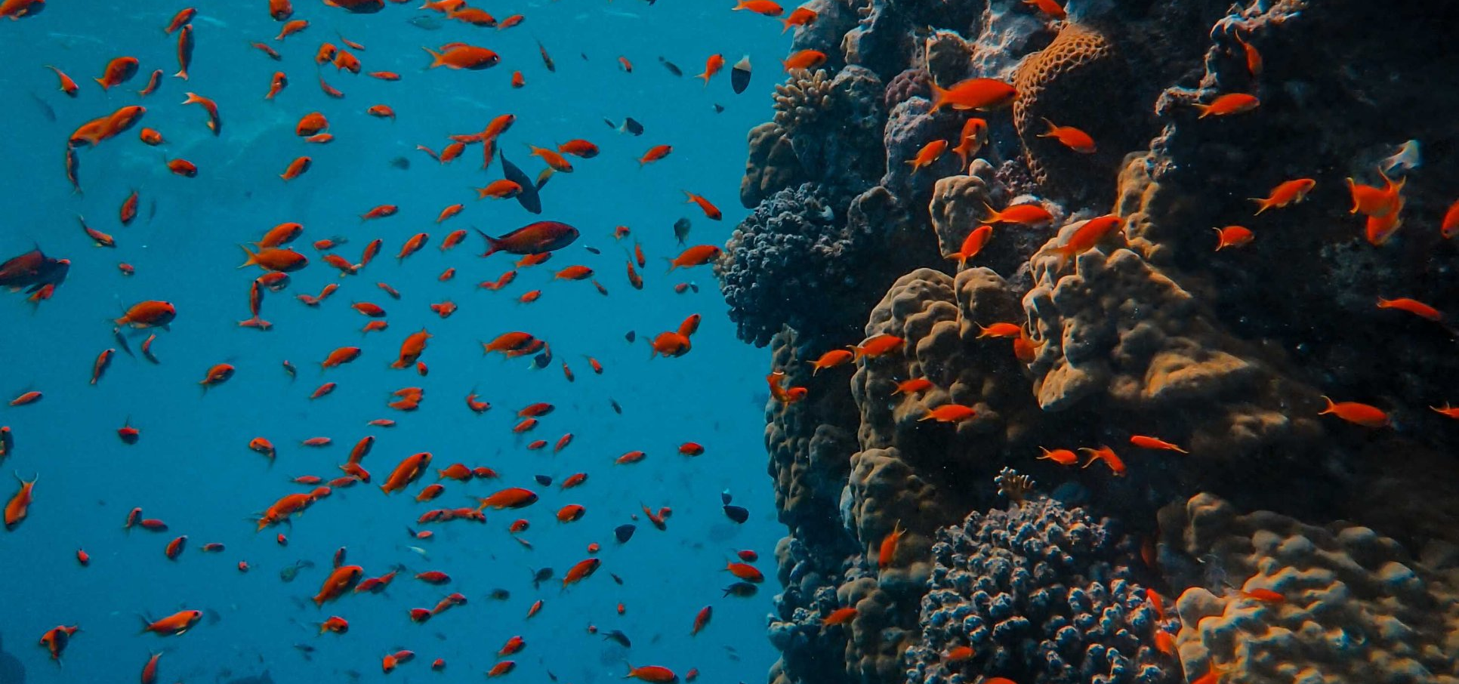
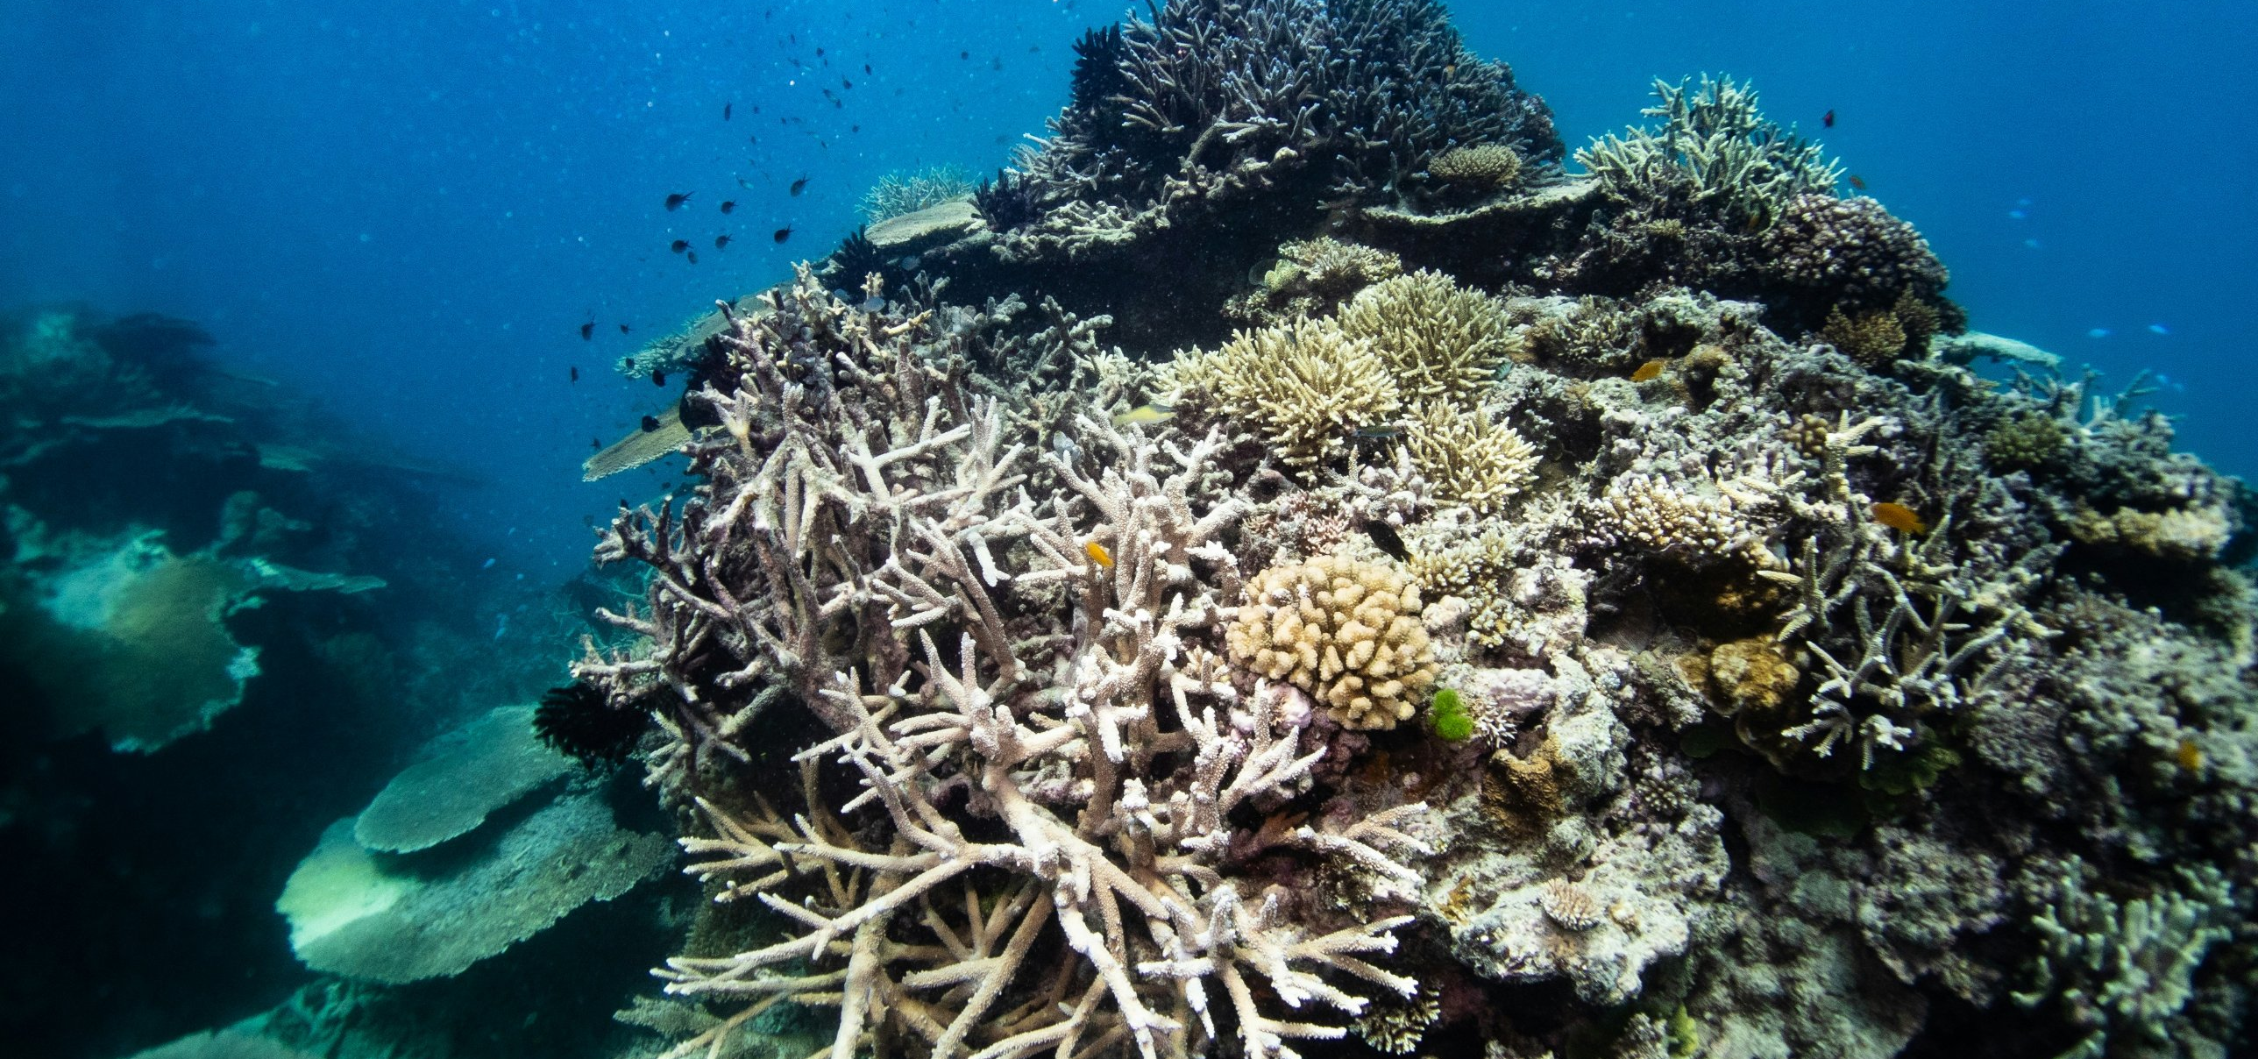
CORALS · 3 / 3
84%
Healthy: colours and fish
of the world’s coral reefs were hit by water warm enough to bleach them (2023–2025)
Is plastic the only problem for corals?
Bleached: the coral loses its colours
Source: NOAA and ICRI, 2025 · Photos: Francesco Ungaro / Pexels; Joan Li / Unsplash
Notes:
Answer: no, heat is too. Make the link: fumes from ships and lorries contain gases that warm the air; the ocean warms up and corals lose their colour (bleaching). If they stay white for too long, they die. The ocean also absorbs CO2, which makes the water more acidic, and local pollution weakens corals further.

Slide 10
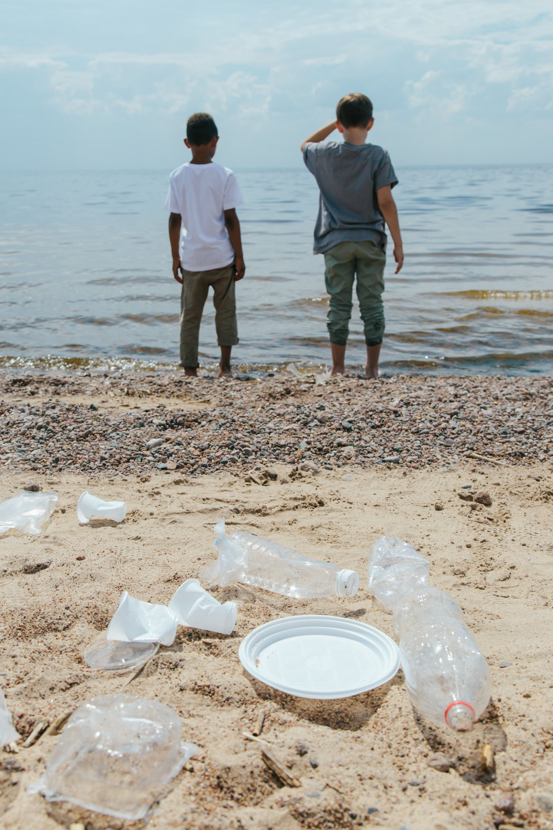
CLOSER TO HOME
Our Belgian beaches
What we find
Most beach litter is plastic
Good news
Every piece we sort or pick up stays out of the sea
Source: OSPAR, Belgian beaches, 2002–2005 (VLIZ) · Photo: Ron Lach / Pexels
Notes:
In the OSPAR beach surveys (2002–2005), about three out of four items of litter found on Belgian beaches were plastic. These are the most recent published figures for Belgium that we have found; outside Belgium, use figures from your own coast if you have them. End on a positive note: “So what can we do? Let’s find out.”

Slide 11
6 · LET’S SORT! · 10 MIN
Which bag? Why? (Brussels)
Blue
Yellow
Orange
White
Plastic bottles, cans and drink cartons (PMD)
Paper and cardboard
Food waste
Everything else
Notes:
These are the Brussels recycling colours; change them to match your local or school rules. Set the task: “In your group, take two or three items each and put them in the right bin. Be ready to say why.” Check: “Do you just put it in a bin, or do you also explain why?” (We explain why.) Only step in if a group disagrees; ask the class to decide first. Tricky items: a chocolate wrapper with foil or plastic goes in blue (paper-only goes in yellow); a banana peel goes in orange; a yoghurt pot goes in blue in Brussels. Check the current rules before the lesson.

Slide 12
7 · MY HOME CHALLENGE · 8 MIN
Choose one thing to try this week
I help sort the packaging at home
I bring a refillable water bottle to school
I find out where three fruits in my kitchen come from
I choose to eat fruit that is in season or grown locally
I tell my family or a friend what I learnt about the ocean
Notes:
Say: “We don’t have to give up chocolate. We can make choices.” Hand out the “My home challenge” sheets. Set the task: “Tick one action you will try this week. Just one.” Check: “How many actions do you tick?” (One.) Learners write their name and take the sheet home to show their family. Follow-up next week (5 minutes): “What did you try? What did your family say?” Praise every attempt, however small.

Slide 13
We don’t have to give up chocolate
We can make choices
Next lesson: what is happening in the ocean?
Notes:
Close on a positive note, without blame or fear. Announce Lesson 2: What is happening in the ocean? The series has four lessons: 1 From chocolate to the ocean, 2 What is happening in the ocean?, 3 Our waves – one sea, many messages, 4 Who acts, and how?

Slide 14
References
Kühn, S. and van Franeker, J. A. (2020). Quantitative overview of marine debris ingested by marine megafauna. Marine Pollution Bulletin, 151, 110858.
NOAA and International Coral Reef Initiative (2025). Fourth global coral bleaching event, January 2023 – March 2025. Reported by The Maritime Executive, 27 April 2025.
OSPAR Commission. Beach litter: monitoring of litter on North-East Atlantic beaches.
The Pew Charitable Trusts and SYSTEMIQ (2020). Breaking the Plastic Wave.
VLIZ – Flanders Marine Institute. SAIL fact sheet no. 14: litter on Belgian beaches (OSPAR data 2002–2005).
Photos: Antoine Giret, Joan Li, Pushpak Dsilva, Julia Zyablova, Tetiana Bykovets (Unsplash); Francesco Ungaro, Ron Lach (Pexels). Free Unsplash and Pexels licences.
Classroom visits and teacher training on sustainability and the SDGs: pendo@drpendomaro.com
© 2026 Dr Pendo Maro · Education series “From chocolate to the ocean” · Lesson 1 of 4 · CC BY-NC 4.0 · Figures checked on 8 October 2026
Notes:
Full links in the teacher guide, References section.

